Slide 1

Women safety device with gps tracking and alerts
S V COLLEGE OF ENGINEERING, TIRUPATI
Department of Electronics and communication Engineering
UNDER THE GUIDANCE OF Mr. B. Gopi Chandra Kumar, M. Tech,
Sr. Asst. Professor, Dept. of ECE,
SVCE, TIRUPATI.
PRESENTED BY
V. Hemanadh 15BF1A04M4
V. S. Sadiya 15BF1A04L6
T. Prudvi Ganesh 16BF5A0450
S. Venkata Sravani 16BF5A0445
S. Sudeep 15BF1A04I2

Slide 2
Contents
Objective
Existing System
Proposed system
Block diagram/flow chart
Tools used
Results
Applications
Conclusion
Future Scope
References

Slide 3
Objective
To alert the guardian of the woman (victim) through alert message if the victim fell into danger.
Alert message should contain the whereabouts of the victim.
To overcome the problem in manually triggered safety device for “No chance” condition.

Slide 4
Existing system and drawbacks
There already exist devices in the market which are intended for women's security.
For instance, Sonata ACT, launched in 2016 Q4 by Titan.
Sends alert message to the guardians via SMS when it’s triggered.
So what’s the concern?
What if there is no chance for user to trigger? Well, that’s where our device comes handy.

Slide 5

Existing System

Slide 6
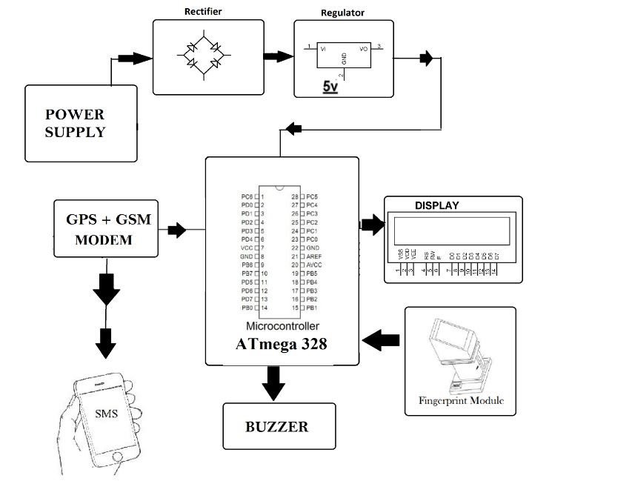
Proposed system
Our proposed system….

Slide 7
Block Diagram
Power supply
ARDUNIO
Mega
Finger print scanner module
LCD
GPS
GSM

Slide 8
Flow chart
START

Slide 9
Flow chart
START
DEVICE POWERED ON

Slide 10
Flow chart
START
DEVICE POWERED ON
FINGER ON READER?

Slide 11
Flow chart
START
DEVICE POWERED ON
FINGER ON READER?
YES

Slide 12
Flow chart
START
DEVICE POWERED ON
FINGER ON READER?
NO
YES
WAIT FOR ’3’ SECONDS

Slide 13
Flow chart
START
DEVICE POWERED ON
FINGER ON READER?
NO
YES
WAIT FOR ’3’ SECONDS
FINGER DETEC-TED?

Slide 14
Flow chart
START
DEVICE POWERED ON
FINGER ON READER?
NO
YES
WAIT FOR ’3’ SECONDS
FINGER DETEC-TED?
YES
FINGER MISMA-CTHED
?

Slide 15
Flow chart
START
DEVICE POWERED ON
FINGER ON READER?
NO
YES
WAIT FOR ’3’ SECONDS
FINGER DETEC-TED?
YES
NO
FINGER MISMA-CTHED
?

Slide 16
Flow chart
START
DEVICE POWERED ON
FINGER ON READER?
NO
YES
WAIT FOR ’3’ SECONDS
FINGER DETEC-TED?
YES
NO
NO
SEND ‘GPS’ DATA TO THE REGD. MOBILE NUMBER THROUGH ‘GSM’.
FINGER MISMA-CTHED
?
YES

Slide 17
Flow chart
START
DEVICE POWERED ON
FINGER ON READER?
NO
YES
WAIT FOR ’3’ SECONDS
FINGER DETEC-TED?
YES
NO
NO
SEND ‘GPS’ DATA TO THE REGD. MOBILE NUMBER THROUGH ‘GSM’.
FINGER MISMA-CTHED
?
YES
ALERT THE GUARDIAN OF THE VICTIM OR POLICE

Slide 18
Flow chart
START
DEVICE POWERED ON
FINGER ON READER?
NO
YES
WAIT FOR ’3’ SECONDS
FINGER DETEC-TED?
YES
NO
NO
SEND ‘GPS’ DATA TO THE REGD. MOBILE NUMBER THROUGH ‘GSM’.
FINGER MISMA-CTHED
?
YES
ALERT THE GUARDIAN OF THE VICTIM OR POLICE
STOP

Slide 19
Tools Used
Hardware:
Arduino Mega 2560
SIM 800 GSM module
Neo6mv2 GPS module
R305 finger print reader
LCD
PCB
Battery / Power supply
Software:
Arduino IDE

Slide 20
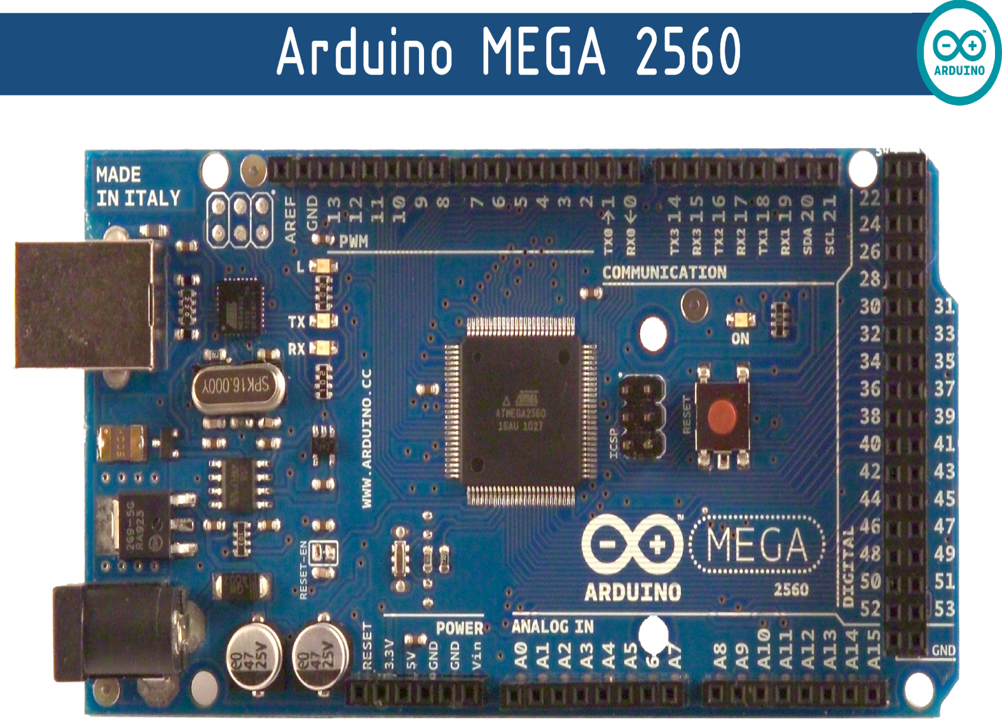
Arduino mega

Slide 21
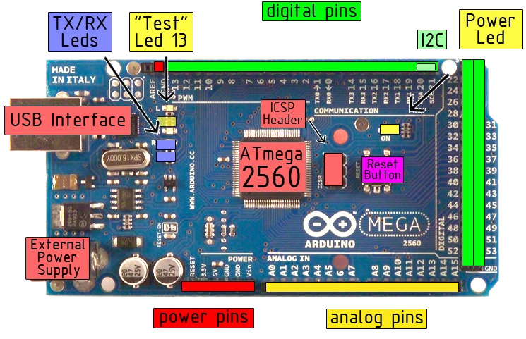

Slide 22
Specifications
The Arduino Mega 2560 is a microcontroller board based on the ATmega2560.
It has 54 digital input/output pins (14 PWM outputs)
16 analog inputs.
4 UARTs (hardware serial ports).
16 MHz crystal oscillator,
USB connection,
Power jack,
ICSP header
Reset button.

Slide 23
Power pins
VIN: The input voltage to the Arduino board (5V).
3.3V: A 3.3 volt supply generated by the on-board regulator.
GND: Ground pins.
MEMORY:
The ATmega2560 has 256 KB of flash memory for storing code
8 KB of SRAM and 4 KB of EEPROM.

Slide 24
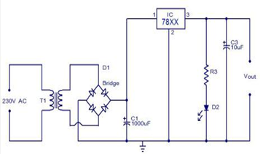
Power supply

Slide 25
Finger print module
It does different functions:
Fingerprint enrollment
Image process
Characters acquisition
Fingerprint template creation
Fingerprint template storage
Fingerprint compare (1: 1, 1: N)
Fingerprint delete
This module can work with different devices based on UAWRT such as PC, SCM and so on.

Slide 26
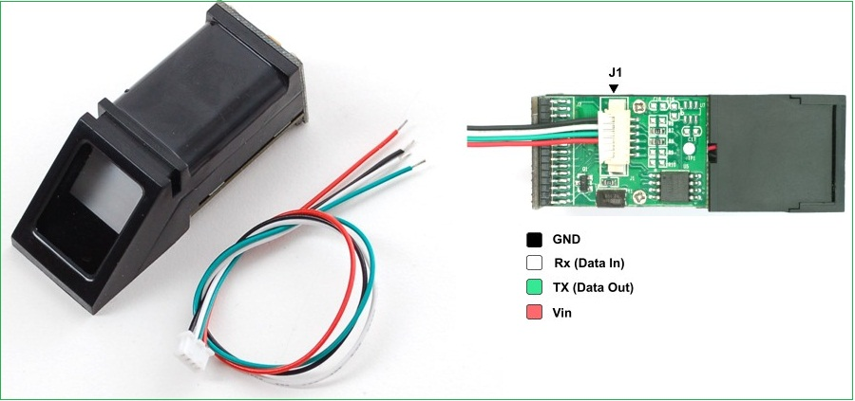
Pin diagram

Slide 27
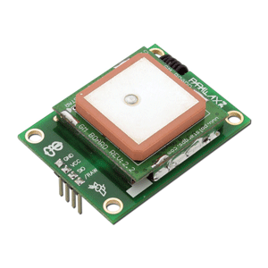
GPS module
Ultra high sensitivity: -165dBm
22 tracking/66 acquisition-channel receiver
WAAS/EGNOS/MSAS/GAGAN support
AGPS support
NMEA protocols (default speed: 9600bps)
One serial port
Embedded patch antenna 12*12*4 mm
Operating temperature range: - 40 to 85°C
RoHS compliant (Lead-free)

Slide 28
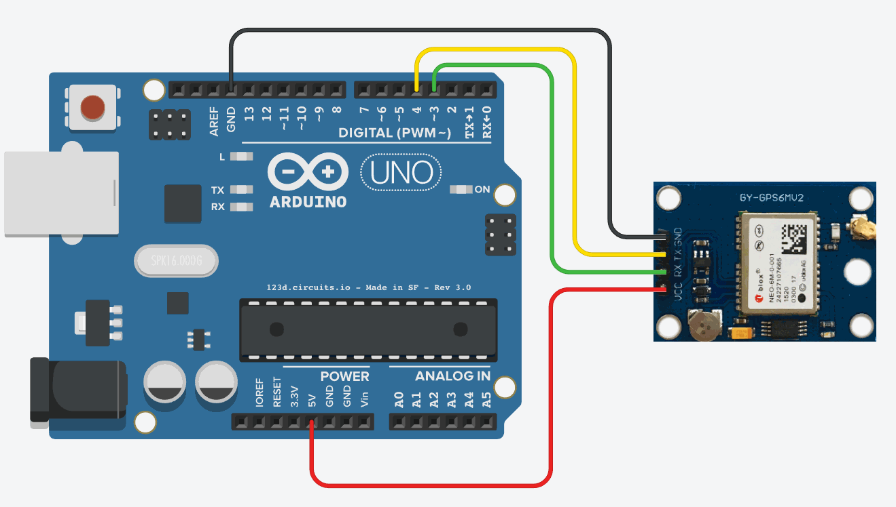
GPS interfacing with arduino
RX
GND
TX
VCC

Slide 29
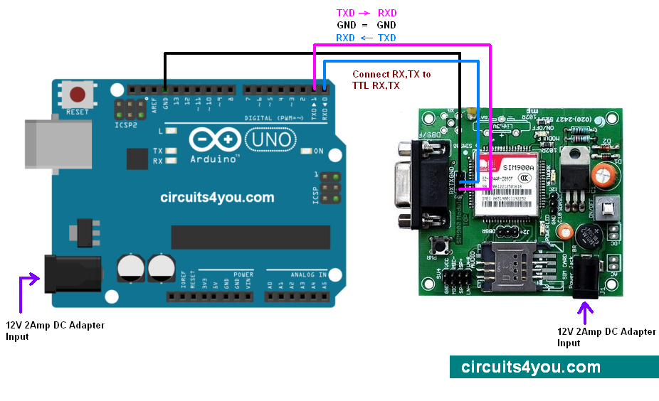
GSM interfacing with arduino

Slide 30
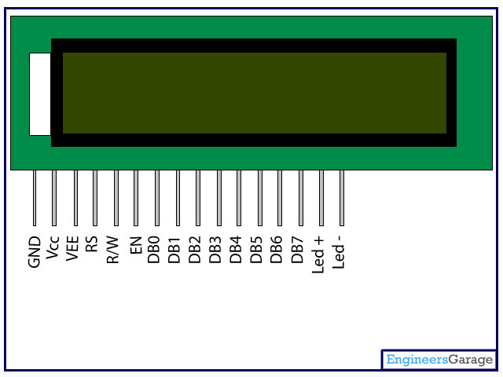
LCD display

Slide 31
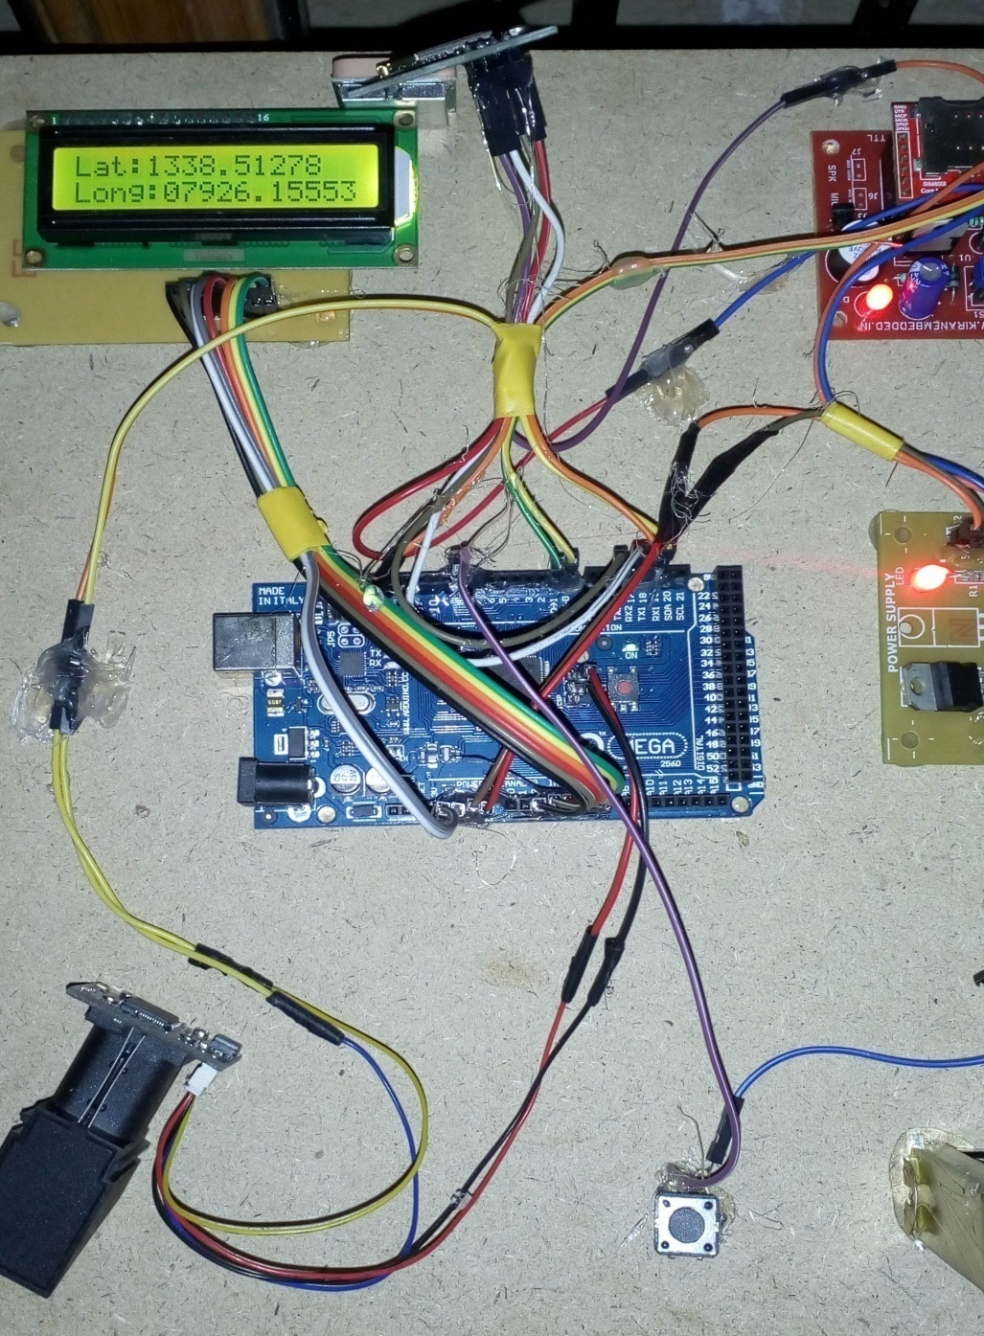
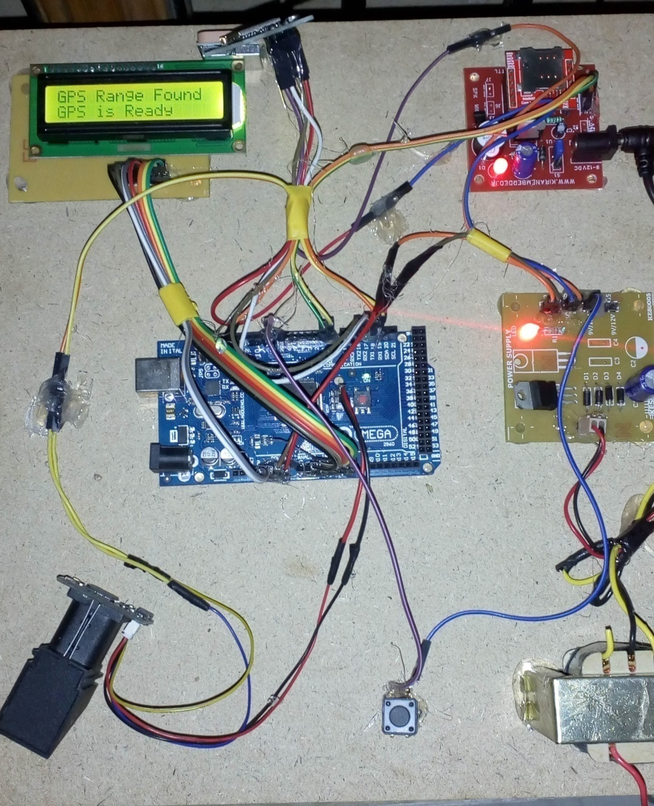
Results:

Slide 32
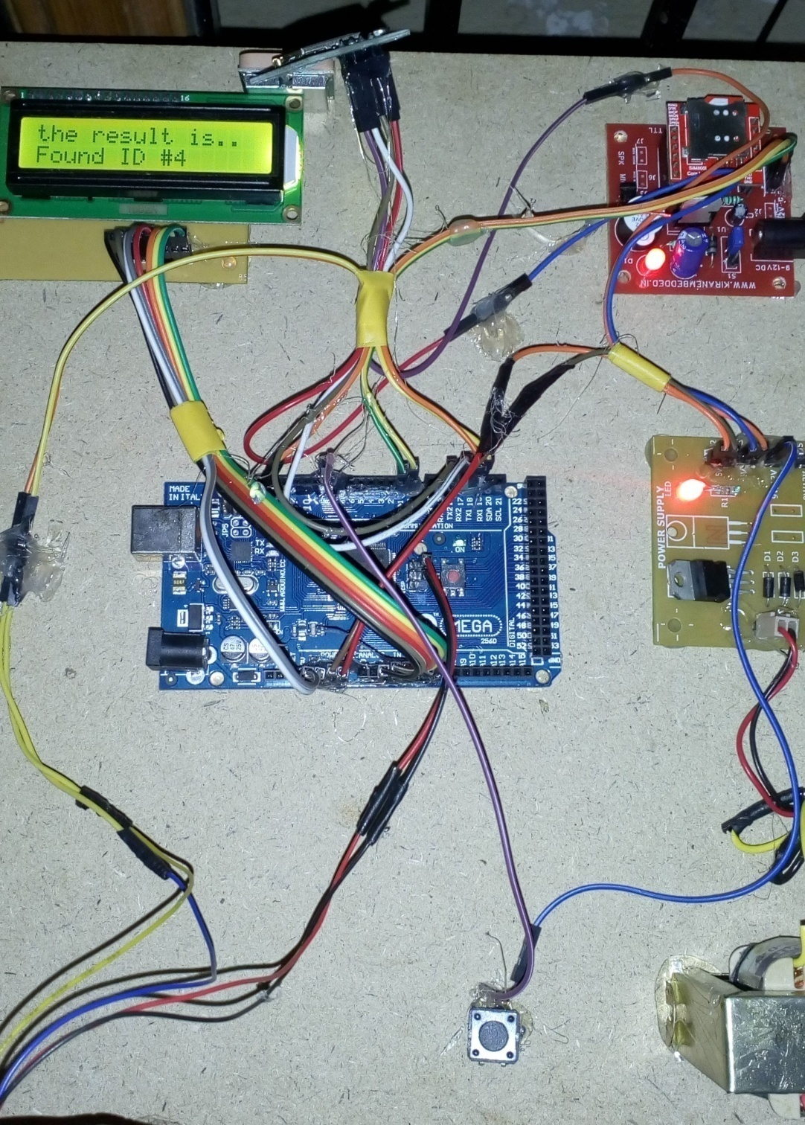
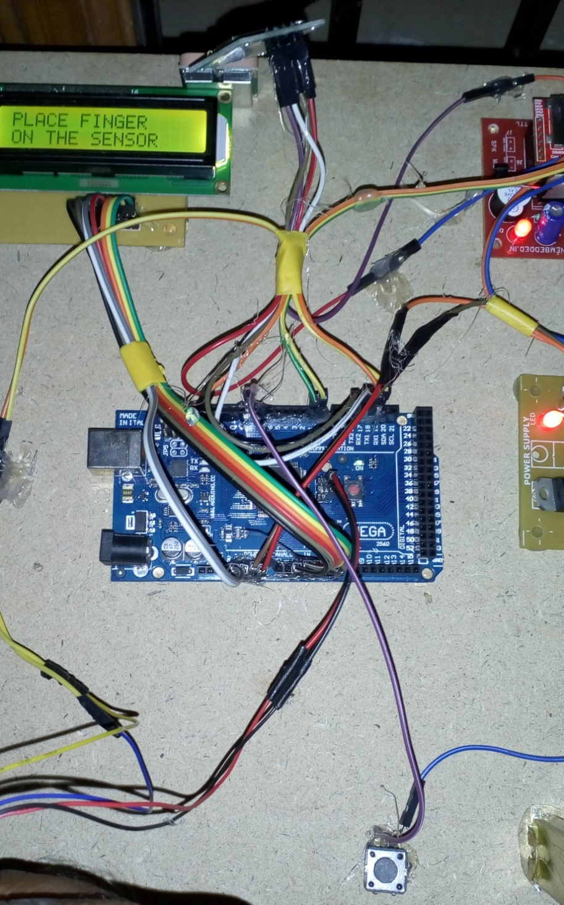
Results:

Slide 33
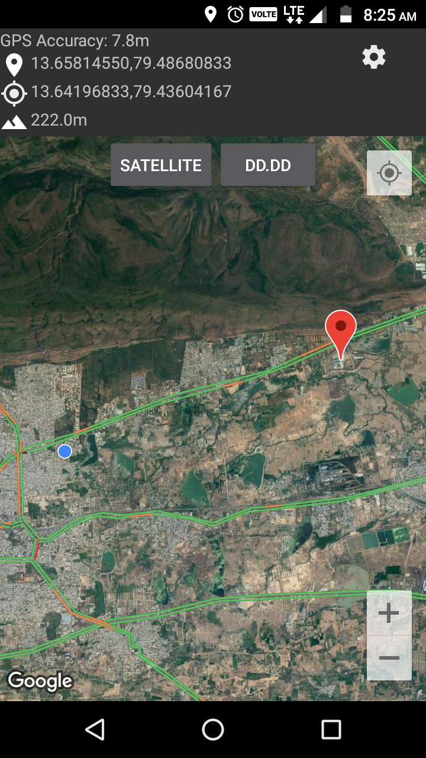
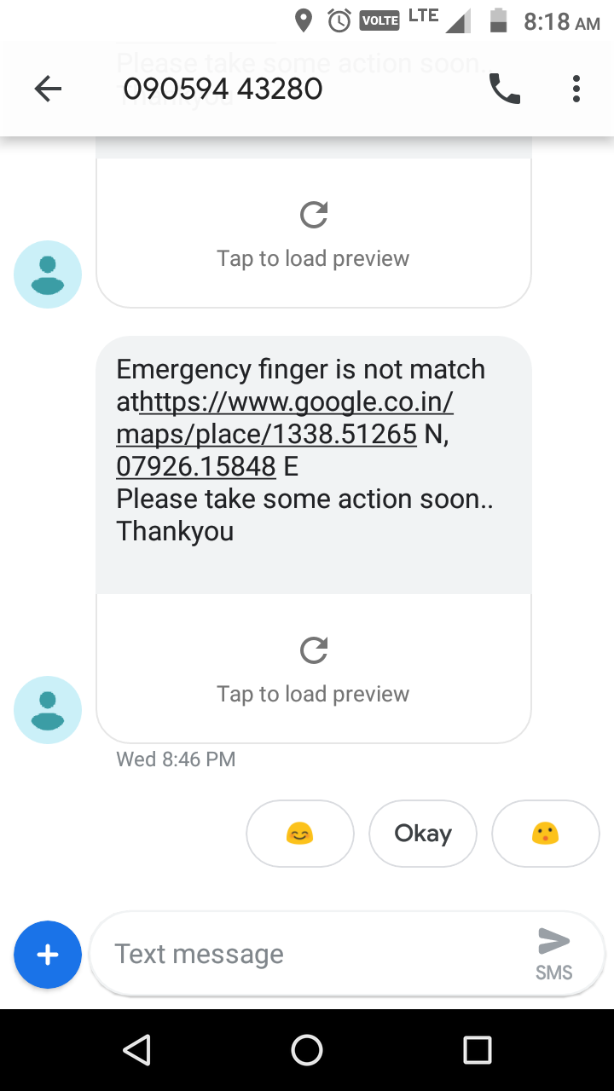
Software results:

Slide 34
Applications
Used for the safety of,
Women
Elderly aged people
Physically challenged people
Legal evidence of crime

Slide 35
Conclusion
In this application an alternative approach for the device triggering is obtained by replacing the manual switch with the fingerprint module.
This approach can eliminate the risk of triggering problems when there is “No chance” condition for the user.

Slide 36
Future scope:
This device can be made so small that it can be used as a hand-band.
Voice messages can be sent during need.
Voice recorder and cam recorder can also be added to the system.

Slide 37
References
“Suraksha. A instrument to help ladies stuck in an unfortunate situation: An action by an understudy of ITM University Gurgaon. efytimes. com. 2013. Available from: http://efytimes.com/e1/118387/SURAKSHA-A-Device-To-Help-Women-In-Distress-An-Initiative-By-A-Student-Of-ITM-University-Gurgaon.pdf”
“Pantelopoulos A, Bourbakis NG. An unmistakable view on sensor-based systems for prosperity checking and foresight. IEEE Transactions on Systems, Man and Cybernetics – part C: Applications and Reviews. 2010 Jan; 40(1):1–12.“
“Toney G, Jaban F, Puneeth S. et al. Diagram and utilization of security arm band for women and children using ARM7. 2015 International Conference on Power and Advanced Control Engineering (ICPACE); Bangalore. 2015 Aug 12-14. p. 300–3.”

Slide 38
Any queries?

Slide 39
Thank You

